Slide 1
Plant/harvest validation with matopiba
July 20, 2018

Slide 2
Plant/Harvest date estimation

Slide 3
In GEE: Timeseries Validation w Matopiba v2
Import quarter period and peak time information from singleCrop_timing_full and doubleCrop_timing_full
Try different plant/harvest estimation methods and validate with Matopiba for all Matopiba survey years instead of just 2017 like the previous version; except now, include summary statistics (per year and method) for the percent of points for which each method gives estimated date within the reported range
There is a ui to look at EVI timeseries of a given point during a given year overlaid with reported plant/harvest and my estimates of plant/harvest
Can also look at magnitude of errors for all point in all years
Can also look at the “sign” (+/-) of errors for all points in a given year

Slide 4
In GEE: Timeseries Validation w Matopiba v2
For the plots below:
Plant estimate 1 = day of minimum
Plant estimate 2 = day of inflection minus 2 weeks
Plant estimate 3 = day of inflection
Harvest estimate 1 = day of inflection
Harvest estimate 2 = day of inflection plus 10 days
Harvest estimate 3 = harvest estimate 2
In the slides below, pick out point-years that have bad estimates and pick out any patterns
In the later years, plant dates tend to be underestimated by the min date; in the earlier years, min date seems ok. In earlier years, plant date tends to be overestimate.
Harvest date always tends to be overestimated for all years
Going forward, judge the success of a method by the error in days instead of the % estimate that lie in the reported range – this is because % estimates within range is biased toward the later years as farmers report smaller and smaller date ranges. Error in days is also biased by the reported range, but probably less so.
Unfortunately, all estimate methods depend on knowing the quarter period, which is badly estimated
In addition to quarter period errors, different fields are planted/harvested at different times RELATIVE to the EVI curve. For example, some fields are harvested before inflection point; others are harvested after the EVI goes flat at the minimum. Perhaps knowing whether something is double cropped will help with this; have two harvest estimation methods depending on single/double crop? Do planting date decisions rely on single/double crop?
There are a couple points that are terrible because reported plant/harvest dates make no sense; take these out going forward.

Slide 5
In GEE: Timeseries Validation w Matopiba v2
Common sources of error:
My estimates of crop timing are bad
Quarter period is too short or long
April 1 is a bad cutoff date (targets second peak instead of first)
EVI timeseries is bad
Natural vegetation
Lots of noise
Variation in the time (relative to EVI curve) of planting/harvest changes – maybe due to wrong pixel location or different behaviors among farmers

Slide 6
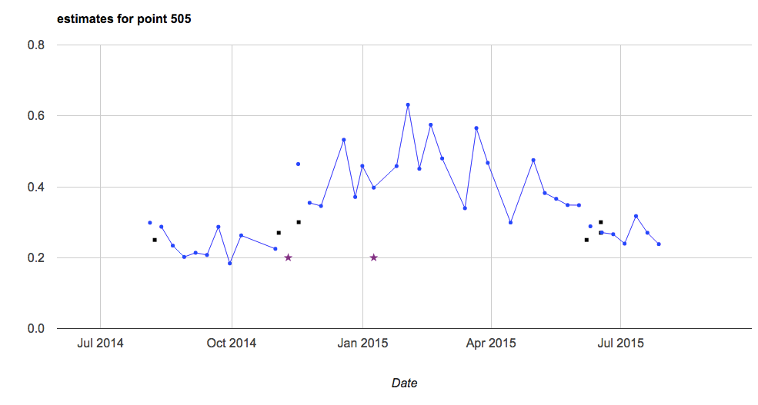
Reason 1: EVI timeseries issue
EVI timeseries makes no sense – natural vegetation, or too much noise. Not something I can fix.
39 points. Common pointIDs: 9, 24, 27, 190, 505 (delete these for all analysis/validation?)
All points affected:
8
9, 9, 9
14
16, 16
23
24, 24, 24, 24
25
27, 27, 27, 27, 27
30, 30
31, 31
112
155
161
164
170
188
189
190, 190, 190, 190
495
502
505, 505, 505, 505

Slide 7
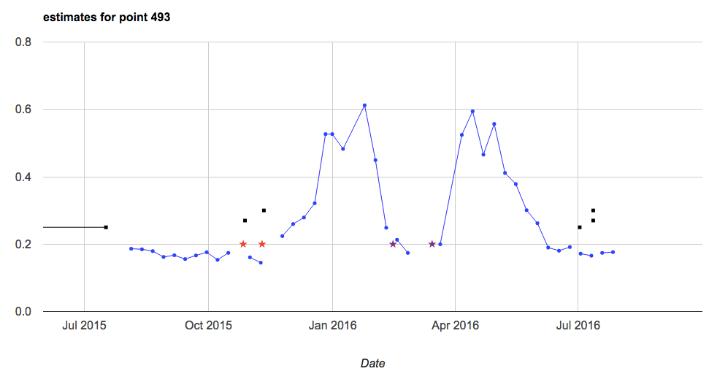
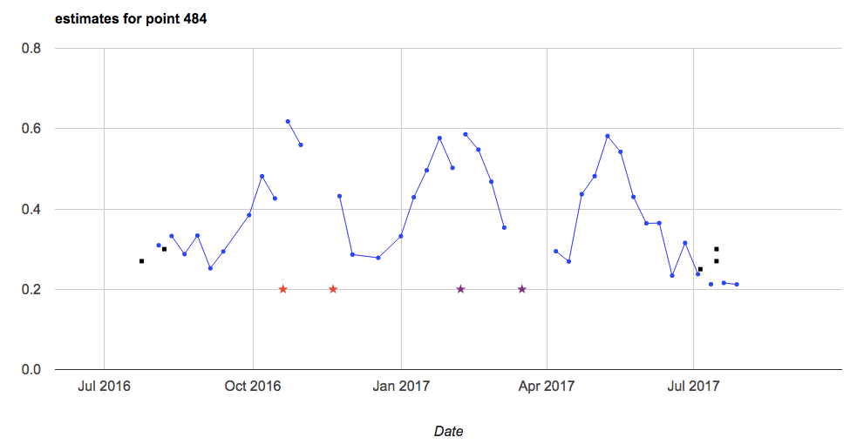
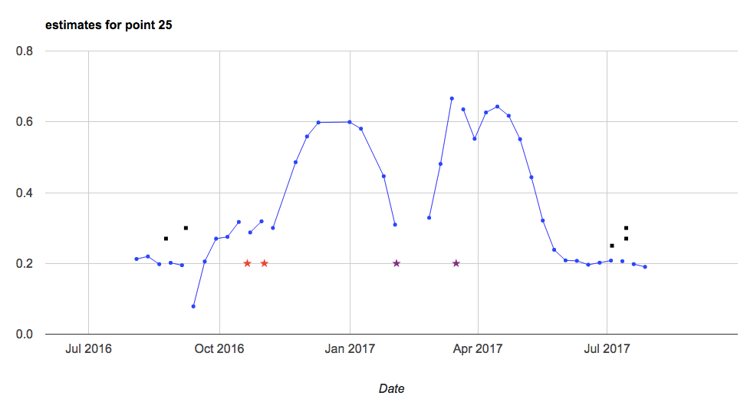
My method didn’t pick up the first peak of a double cropped pixel because second peak occurred before April 1, resulting in very large quarter period, leading to underestimated plant and overestimated harvest date
6 points affected.
PointIDs that are affected:
19
25
482
484
493
496

Slide 8
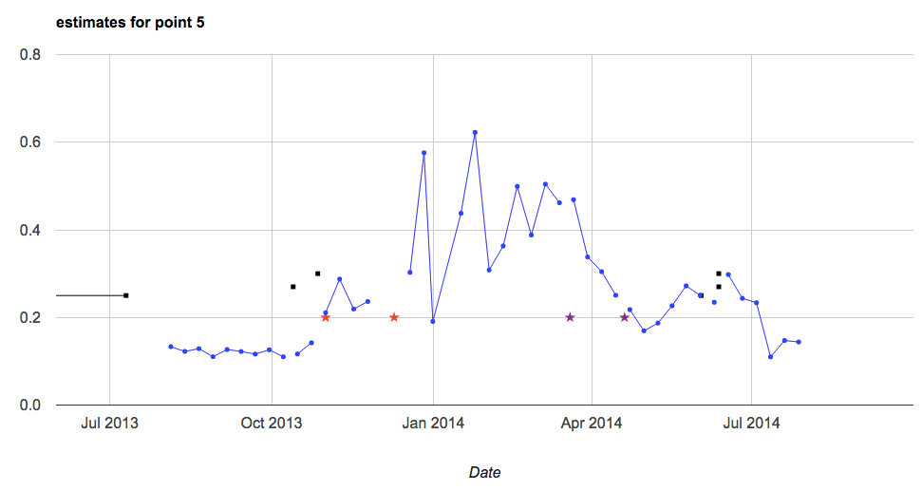
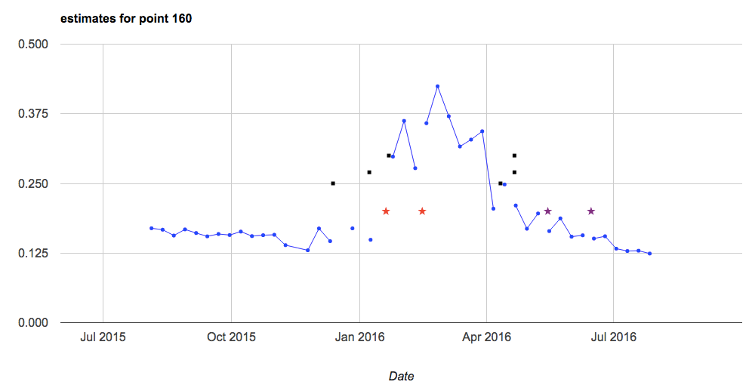
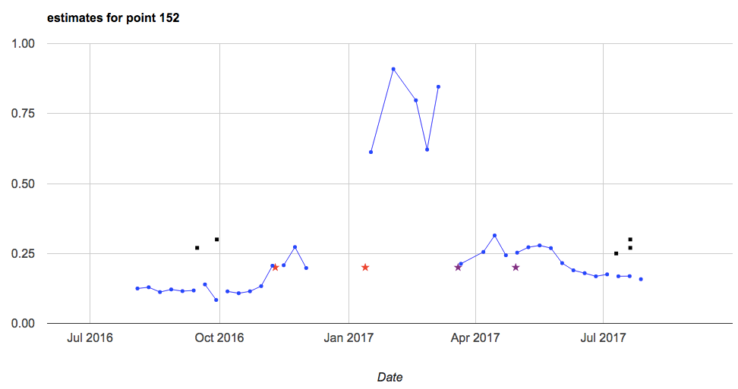
Quarter period is overestimated, causing plant estimates that are too early and harvest estimates that are too late
3 points affected
pointIDs affected:
5
160
152

Slide 9
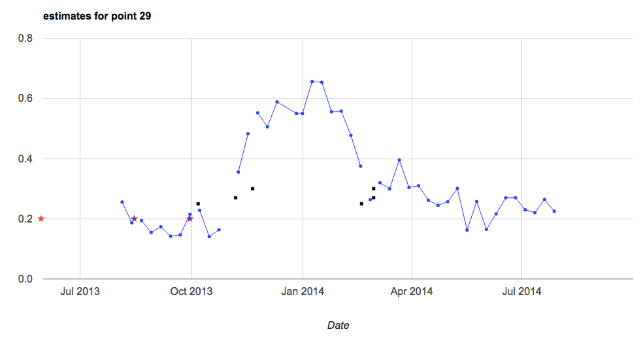
Reported plant/harvest makes no sense (point 29)

Slide 10
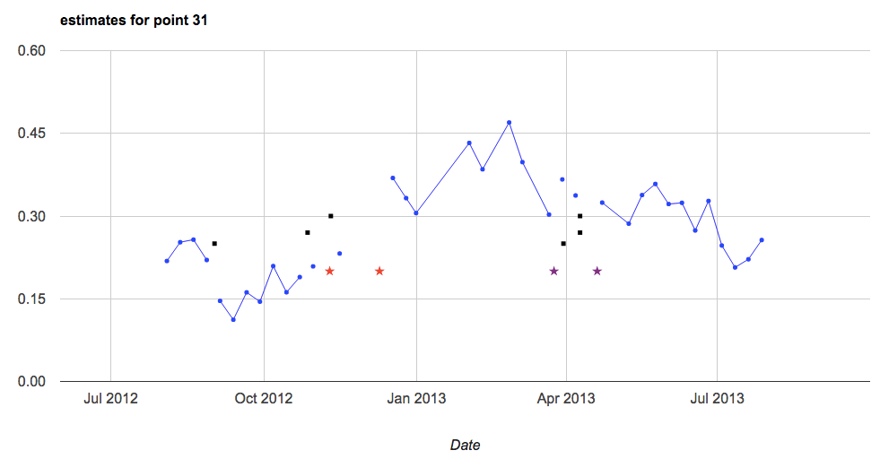
Plant date: minimum happened too early but the rest of the estimates are ok
14 points affected
No obvious trend in points or years affected
pointIDs and years affected:
10, 2010
15, 2013
20, 2016
25, 2014
28, 2016
31, 2012, 2016
170 ,2017
179, 2014
188, 2010
189, 2010, 2011
482, 2016
505, 2011

Slide 11
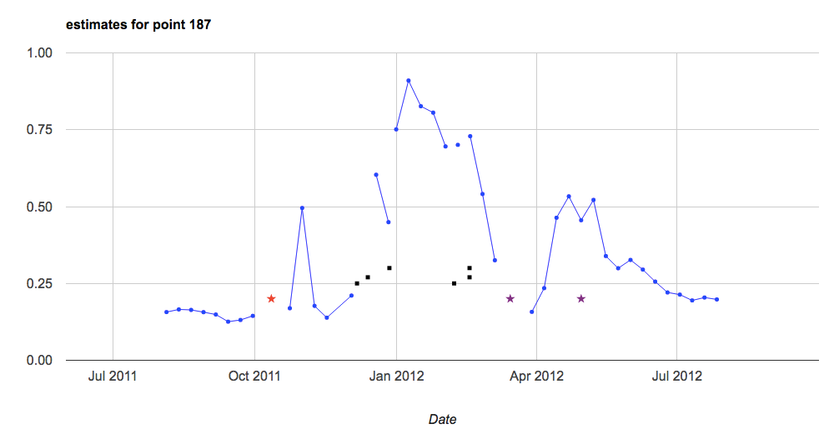
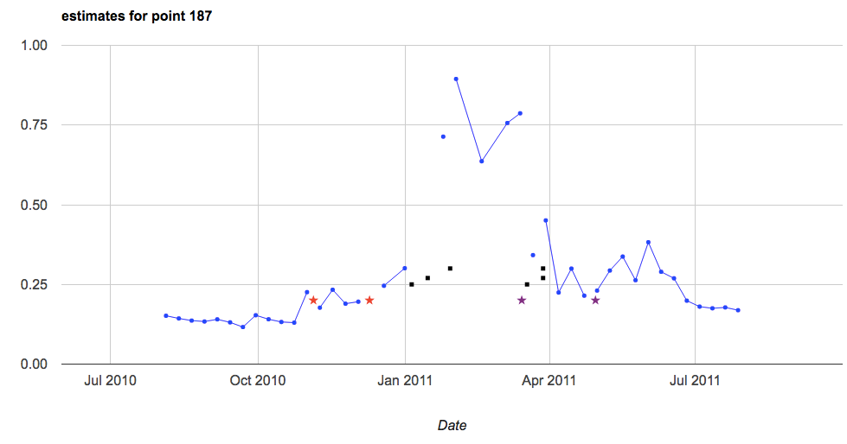
Very steep EVI curve caused quarter period to be underestimated, so estimated plant dates are too late and estimated harvest dates are early (or on the early side, even if it’s still within range) – generally we tend to overestimate harvest date so sometimes even with very small quarter period, we will still overestimate harvest date
7 points affected, no obvious trend in points or years
pointIDs affected:
5
8
25
174
179
187, 187

Slide 12
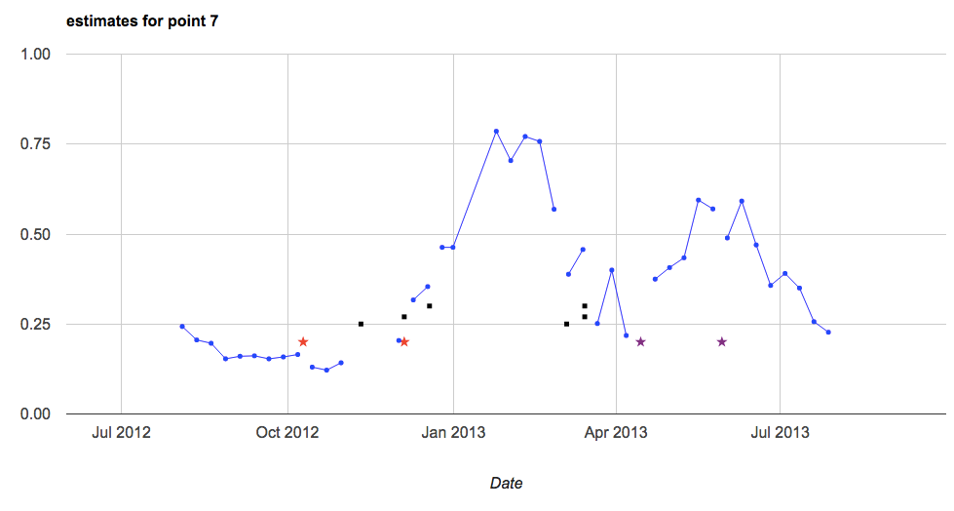
Harvest is overestimated but planting is ok, indicating that harvest usually begins before inflection point
3 points affected
Points affected:
7
19
179

Slide 13
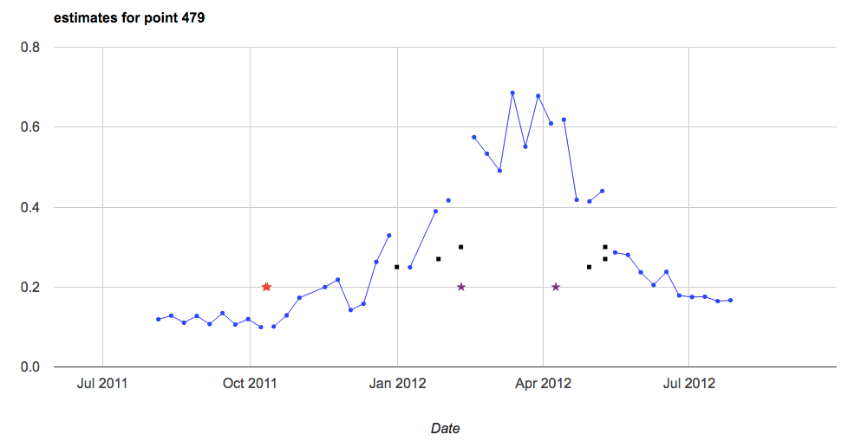
Shifts in the time (relative to shaped of EVI curve) that the field is planted/harvested – we can try for a happy medium given single/double crop info (or maybe weather info?) but otherwise this is not controllable. Also may be due to mislocated pixel.
About 15 pixels affected, harvest is usually biased toward earlier than inflection point
Some pixels repeatedly have harvest during peak EVI (8, 25, 479)
Harvest is near inflection
27, 152
Harvest is between peak and inflection
5
Harvest is during the peak EVI
479, 8, 25, 8, 25, 479, 182
Harvest is around minimum EVI
187

Slide 14
In GEE: Timeseries Validation w Matopiba v2
Adjust method to get better plant/harvest estmates
Get rid of repeatedly problematic points (pointID 29, bad reported plant/harvest; pointID 9, 24, 27, 190, 505 because they tend to be natural vegetation)
Don’t estimate planting date with min date anymore; it tends to be early. Try for some averaging between min and inflection date, with bias toward inflection date
Estimate harvest closer to the peak time/inflection time; don’t go beyond inflection date
Plant estimate 1: infl day
Plant estimate 2: avg between min day and infl day
Plant estimate 3: min day plus 75% of quarter period (i.e. between min day and infl day, biased toward infl day)
Harvest estimate 1: infl day
Harvest estimate 2: avg between peak day and infl day
Harvest estimate 3: peak day plus 75% of quarter period (i.e. between peak day and infl day, biased toward infl day)

Slide 15
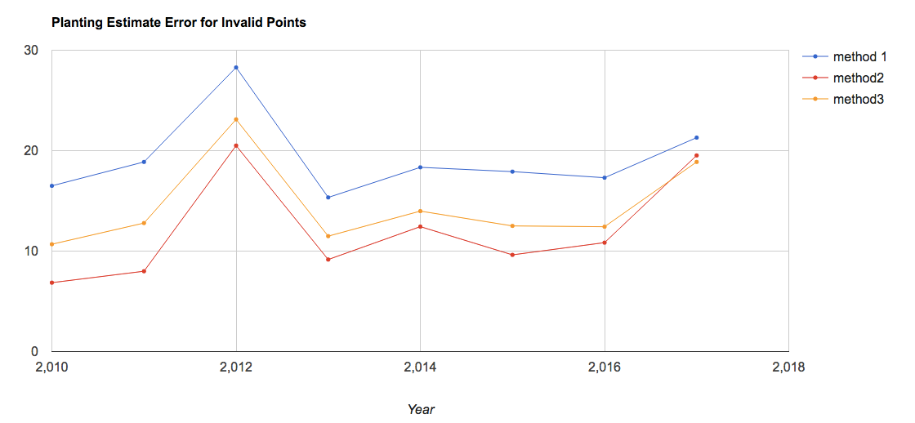
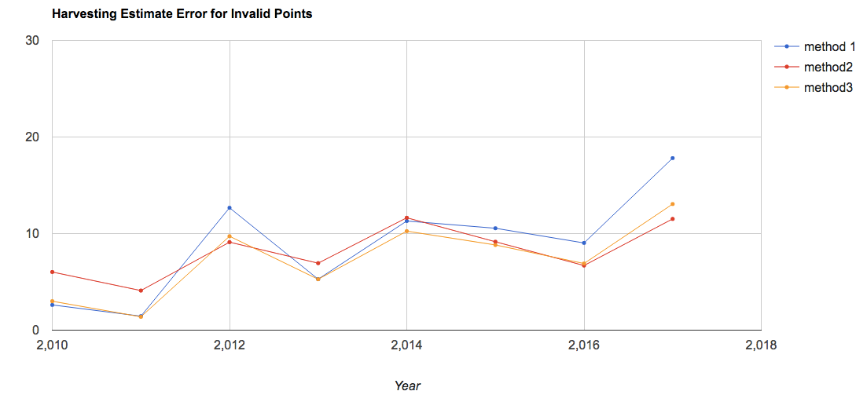
Observations
For planting estimates, estimate method 2 has lowest error for “out of range” estimates AND highest percent of points that are within range for all years
For harvesting estimates, it’s unclea which is the best. Method 1 has the highest percent of “within range” points, but not always the lowest error for the “out of range” estimates. Method 2 has lowest percent of “within range” estimates, but of the invalid points, the error is lowest and there are fewer very bad estimates – so Method 2 is preferable because we’re targeting estimation error rather than % correct.
For later years, there can be a handful of very bad estimates (more than 50 days RMSE) – maybe due to combo of tighter reported range and more points in general.

Slide 16
Observations
In earlier years, harvest estimate tends to be too early. Starting in 2012, some harvest estimates begin to be overestimated; however, fewer points are overestimated than underestimated for all the years.
Plant dates tend to be overestimated for all years except 2017, which has about equal number of points overestimated vs underestimated; and the underestimated points are huge (80 – 150 days RMSE) – perhaps this can be taken out with a “reasonable limit” for estimates

Slide 17
In GEE: Timeseries Validation w Matopiba v3
Use plant/harvest estimates CAR polys to compare to reported ranges
As before, calculates the mean of the pixel estimates within CAR poly and compares to the ranges. Two types of ranges:
Full range (min to max) estimates
Interquartile range of estimates
Unlike before, calculates a measure of how well the estimated range overlaps with actual range
The measure is “intersection measure” = (days of overlap)^2/(days of reported range x days of estimated range) Another measure is “useless days” = "how much of estimated range is useless" = (range of estimate outside of actual range)
Note that if the range for either the estimate or the survey report is zero days, advanced the end of the range by one day because otherwise there will be no intersection

Slide 18
In GEE: Timeseries Validation w Matopiba v3
Cleaned up the repetitiveness of charting and cleaning data by adding new functions
Next:
look at why certain points are so badly estimated. Filter out pixels with unreasonable interquartile ranges; need to also get rid of polys whose entire area is masked out and count number of polys that are totally masked out
Map pixels with bad quarter periods – what percent of pixels have bad quarter periods?
Does timing of harvest relative to EVI TS change depending on single/double crop?
Plot individual estimate dates vs. polys for a given year; each poly will have multiple dots for each pixel within that poly; also overlay the actual range

Slide 19
Tests/validation methods for plant/harvest estimates:
From (Urban et al, 2018):
Calculate RMSE, bias, correlation (for interannual variability – R2 and Pearson correlation) and map them to see any spatial patterns in error
Relate bias to season’s avg rain and T, and to fraction natural vegetation to see how error is affected by those factors
Compare estimated plant anomaly (year’s estimated plant date minus average estimated plant date) to actual anomaly. Compare how well anomalies are correlated. And look at how well the estimated spatial pattern of interannual variability matches the spatial pattern of observed variability. Compare boxplots of estimated vs actual anomalies each year
From (Gao et al, 2017):
Can compare a surveyed plant/estimate to RS-based metrics, like peak time and inflection point. There will be a bias, but hopefully also a correlation (see if they follow the same pattern over time and space)
Plot inflection pt or peak vs plant/harvest data (to see whether peak or inflection point has better correlation with data)
Plot year vs DOY for peak, inflection and plant/harvest data over all polygons – essentially peak, inflection, plant data, harvest data will be separate lines on the same plot
Plot polygon vs DOY for peak, inflection and plant/harvest data over all years (or over individual years) – essentially peak, inflection, plant data, harvest data will be separate lines on the same plot

Slide 20
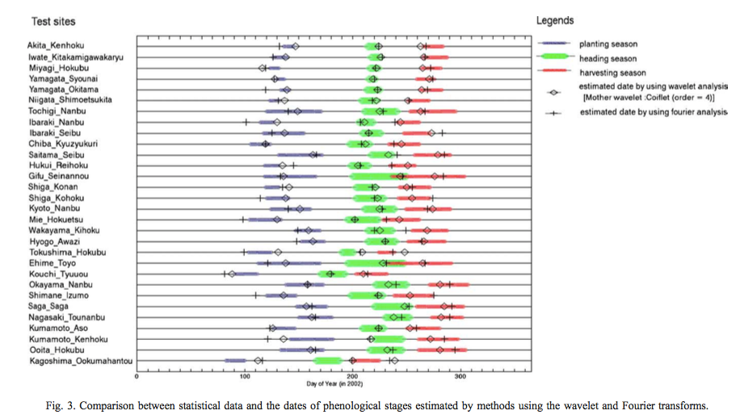
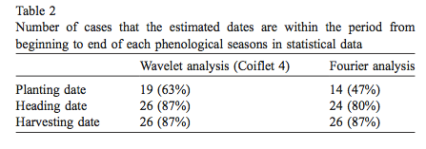
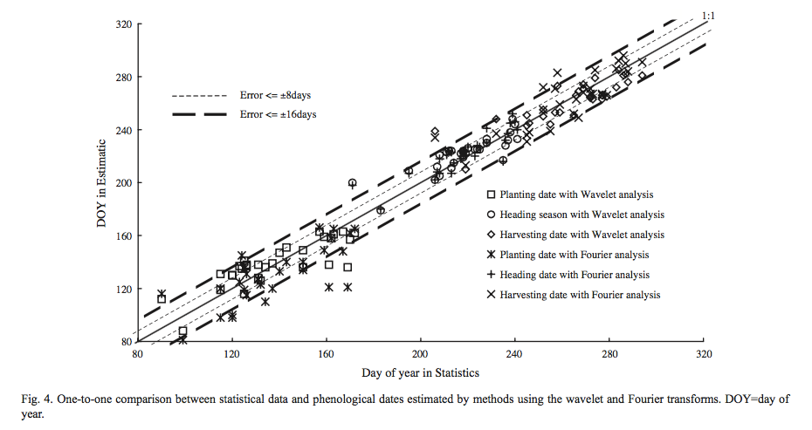
(Sakamoto et al, 2005)
Repeat Fig 4 for growing period (i.e. growing period in data vs growing period in my estimates)
Calculate number of cases (or percent cases) in which estimation error exceeds 16 days
Produce the graphs below
Compare my results to their Table 2

Slide 21
Qual

Slide 22
Form: Higher Degree Committees
Need: exam date
3-5 subject areas (crop modeling, remote sensing, timeseries analysis, causal statistics, land use change)
Committee:
Chair from CEE
ASR (academic senate member) NOT from department
Overall committee must be at least 50% from CEE
Questions about Crop Timing to ask:
How does my estimated peak -> harvest/browndown compare to GDD/thermal time?
For qual, propose the following: (1) plant/harvest date estimation, (2) analyzing plant/harvest date estimation as proxy for farmer behavior over history, (3) something with the statistical crop model.

Slide 23
To Do

Slide 24
To Do – LAI timeseries
Match up Matopiba and CARpolys by farmer name
See if Dave or Jake can upload GOME data. See if Avery gets STAIR information.
explore an approach that lets you use some goodness of fit type metric to let you select your frequency parameter in your harmonic curve fitting scheme.
One key thing is to transition the data cleaning steps to code if you haven’t already. recreate/document the cleaning you already conducted using a code based tool. R would be ideal. This is the best tactics for cleaning data because we it is transparent and allows error tracing
Put in GEE a way to get a sense of the spread in planting, harvest dates and how different pixels look from each other
Fit planting date to onset map for running hypothetical pixels.
Look up pyramiding for continuous vs categorical rasters.
Look at manuscripts for methods, tests that people are doing in plant/harvest estimate, use this to come up with additional questions to ask, methods
Explore adding SIF and other RS data; merging Landsat with MODIS
Look up triple co-location (adding new satellite data to triangulate plant/harvest estimate)

